Slide 1
Introduction to Control Statements
Objectives:
  Use the increment and decrement operators.
  Use if and if-else statements to make choices.
  Use while and for loops to repeat a process.
  Construct appropriate conditions for control statements using relational operators.
  Detect and correct common errors involving loops.

Slide 2
Introduction to Control Statements
  iteration
  off-by-one error
  overloading
  random walk
  sentinel
  task-controlled loop
Vocabulary:
  control statements
  counter
  count-controlled loop
  flowchart
  infinite loop

Slide 3
Control Structures
A. Sequence
  Instructions executed in order 1st , 2nd , 3rd, etc.
B. Selection
  Branching, Conditionals
    if, if else
    Switch statements (not part of APCS Java Subset)

Slide 4
Control Structures
C. Repetition (Iteration )
  Indefinite Loops
    while loop
      (condition checked at beginning)
    do…while (not part of APCS Java Subset)
      (condition checked at the end of the loop)
  Definite Loops
    for loop
D. Recursion

Slide 5
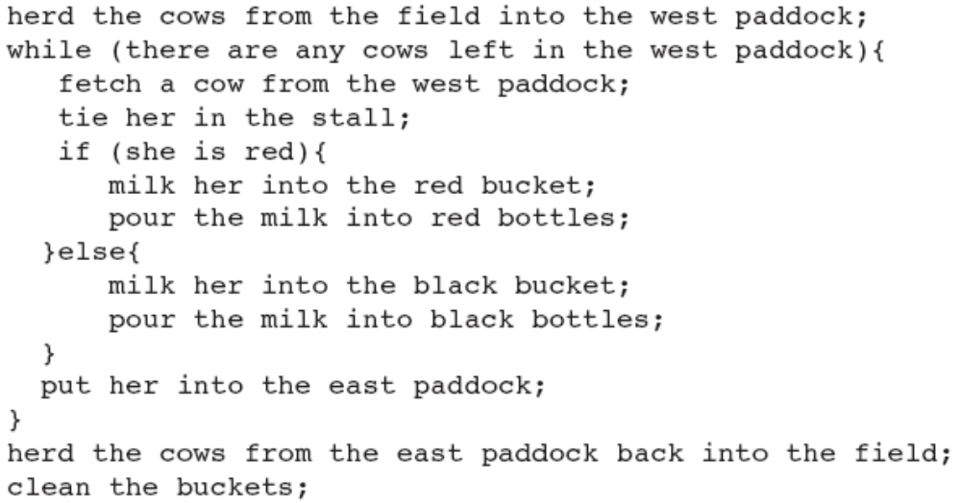
Pseudocode

Slide 6
Control Statements
  While and if-else are called control statements.
    Means do the stuff repeatedly as long as the condition holds true
    Means if some condition
    is true,
    do stuff 1,
    and if it is false,
    do stuff 2.
while (some condition)
{
do stuff;
}
if (some condition)
{
do stuff 1;
}
else
{
do stuff 2;
}

Slide 7
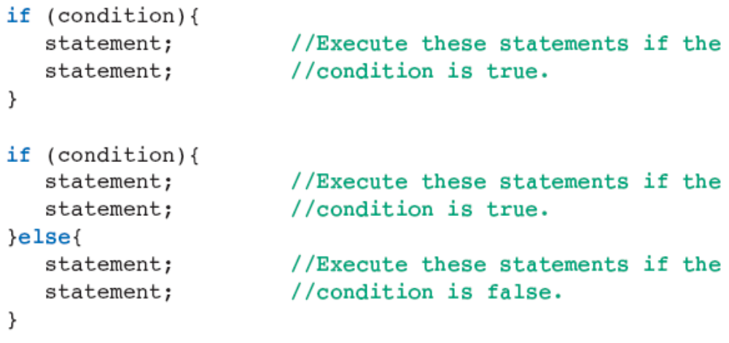
The if and if-else Statements
Principal Forms
  In Java, the if and if-else statements allow for the conditional execution of statements.

Slide 8
The if and if-else Statements
  The indicated semicolons and braces are required
  Braces always occur in pairs
  There is no semicolon immediately following a closing brace.

Slide 9
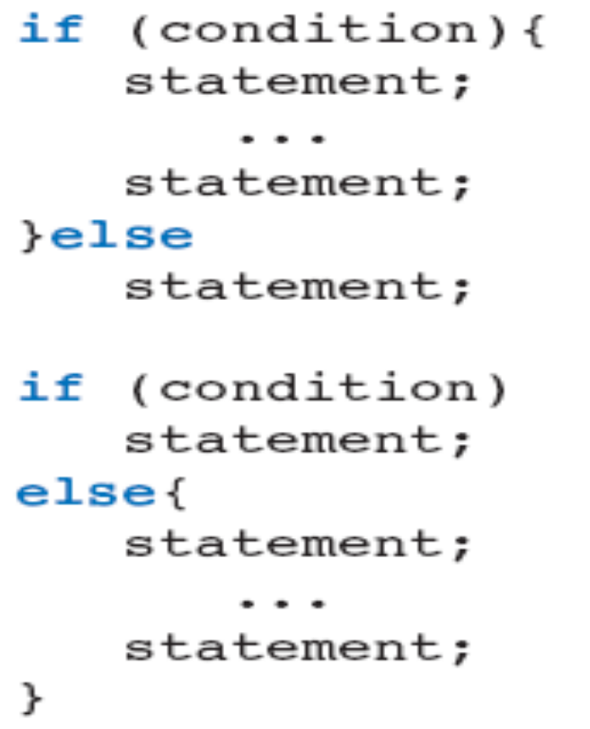
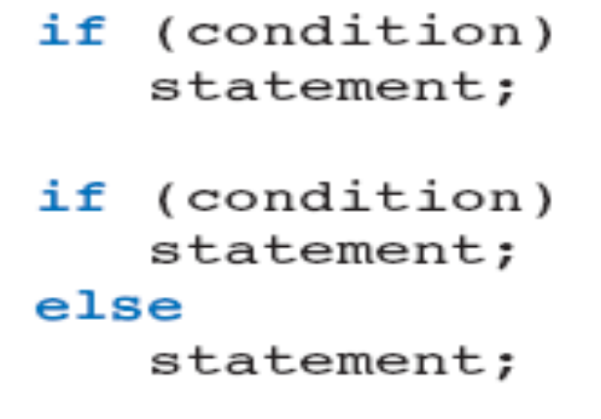
The if and if-else Statements (cont.)
Additional forms:

Slide 10
The if and if-else Statements (cont.)
Better to over-use braces than under-use them
  Can help to eliminate logic errors
Condition of an if statement must be a Boolean expression
  Evaluates to true or false
A flowchart can be used to illustrate the behavior of if-else statements.

Slide 11
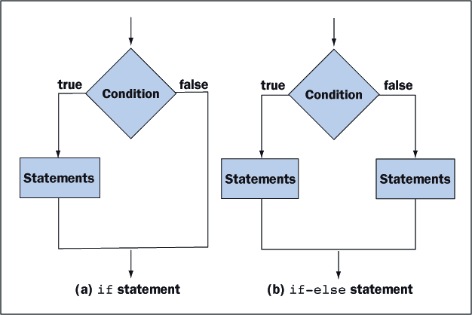
The if and if-else Statements
Figure 4-1 shows a diagram called a flowchart that illustrates the behavior of if and if-else statements.

Slide 12
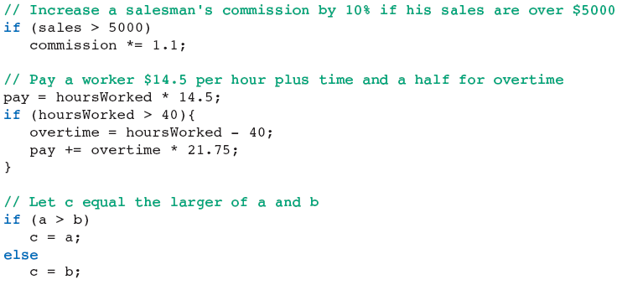
The if and if-else Statements
Examples:

Slide 13
Compound Boolean Expressions
Logical Operators
  And && (two ampersands) Conjunction
  Or || (two pipe symbols) Disjunction
  Not ! (one exclamation point) Negation
Use parentheses for each simple expression and the logical operator between the two parenthetical expressions.
  i.e. ((grade >= 80) && (grade < 90))

Slide 14
Truth Tables for AND / OR
Expression1 Expression2 E1&&E2 E1||E2
(E1) (E2)
true true true true
true false false true
false true false true
false false false false

Slide 15
Truth Table for NOT
Order of Priority for Booleans
Expression Not E
(E) !E
true false
false true
Order Of Priority in Boolean Expressions
  1. !
  2. &&
  3. ||

Slide 16
Order of Operations including Booleans
1. ( )
2. !
3. *, /, %
4. +, -
5. <, <=, >, >=, = =, !=
6. &&
7. ||

Slide 17
Complements
Operation
! <
! <=
! >
! >=
Complement (equivalent)
>=
>
<=
<

Slide 18
De Morgan’s Laws
! ( A && B) is the same as: !A || !B
Not (true AND true) Not(true) OR Not(true)
Not (true) false OR false
false false
!( A || B) is the same as: !A && !B
Not( true OR true) Not(true) AND Not(true)
Not (true) false AND false
false false

Slide 19
The while Statement
  The while statement provides a looping mechanism that executes statements repeatedly for as long as some condition remains true.
      while (condition) //loop test
      statement; //one statement inside the loop body
      while (condition) //loop test
      {
      statement; //many statements
      statement; //inside the
      ... //loop body
      }

Slide 20
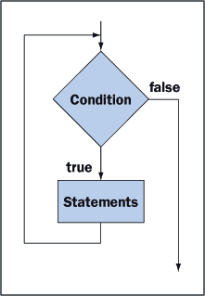
The while Statement
  If the condition is false from the outset, the statement or statements inside the loop never execute. Figure 4-2 uses a flowchart to illustrate the behavior of a while statement.

Slide 21
The while Statement
Compute 1+2+…+100 (Count-controlled Loops)
  The following code computes and displays the sum of the integers between 1 and 100, inclusive:
  // Compute 1 + 2 + … + 100
  int sum = 0, counter = 1; //Initialize sum and counter before loop
  while (counter <= 100)
  {
  sum += counter; //point p (we refer to this location in Table 4-4)
  counter ++; // point q (we refer to this location in table 4-4)
  }
  System.out.println (sum);

Slide 22
The while Statement: count controlled loop
  The variable counter acts as a counter that controls how many times the loop executes.
  The counter starts at 1.
  Each time around the loop, it is compared to 100 and incremented by 1.
  The code inside the loop is executed exactly 100 times, and each time through the loop , sum is incremented by increasing values of counter .
  The variable counter is called the counter.

Slide 23
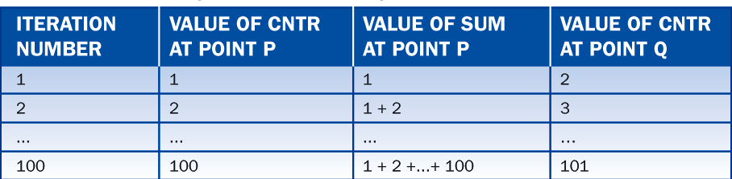
The while Statement
Tracing the Variables
  To understand the loop fully, we must analyze the way in which the variables change on each pass or iteration through the loop. Table 4-4 helps in this endeavor. On the 100th iteration, cntr is increased to 101, so there is never a 101st iteration, and we are confident that the sum is computed correctly.

Slide 24
The while Loop Accumulator
Write code that computes the sum of the
numbers between 1 and 10.
int counter = 1;
int sum = 0;
while (counter <= 10)
{
sum = sum + counter;
counter = counter + 1;
}

Slide 25
Exercise
P119 Computer factorial

Slide 26
The while Statement
Counting Backwards
  The counter can run backward.
  The next example displays the square roots of the numbers 25, 20, 15, and 10
  Here the counter variable is called number:
    // display the square roots of 25, 20, 15, and 10
    int number = 25;
    while (number >= 10)
    {
    System.out.println (“The square root of” + number + “is” + Math.sqrt (number));
    number -= 5;
    }

Slide 27
The while Statement
The output is:
    The square root of 25 is 5.0
    The square root of 20 is 4.47213595499958
    The square root of 15 is 3.872983346207417
    The square root of 10 is 3.1622776601683795

Slide 28
The while Statement
Task-Controlled Loop
  Task-controlled loops are structured so that they continue to execute until some task is accomplished
  The following code finds the first integer for which the sum 1+2+…+n is over a million:
      // Display the first value n for which 1+2+…+n
      // Is greater than a million
      int sum = 0;
      int number = 0;
      while (sum<= 1000000)
      {
      number++;
      sum += number;
      }
      system.out.println (number);

Slide 29
The while Statement
Common Structure
  Loops typically adhere to the following structure:
    initialize variables //initialize (a “primed” while loop)
    while (condition)
    { //test
    perform calculations and //loop
    change variables involved in the condition //body
    }
  In order for the loop to terminate, each iteration through the loop must move variables involved in the condition significantly closer to satisfying the condition.

Slide 30
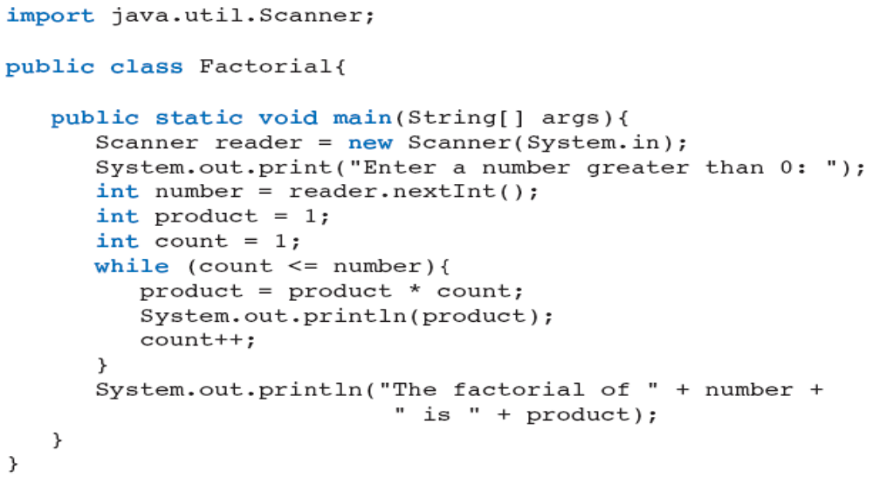
Using while to Compute Factorials
Example 4.2: Compute and display the factorial of n

Slide 31
Using while to Compute Factorials
Example 4.2: Compute and display the factorial of n

Slide 32
while Loops: Discussion
  The condition can be any valid Boolean Expression
  The Boolean Expression must have a value PRIOR to entering the loop.
  The body of the loop can be a compound statement or a simple statement.
  The loop control condition needs to change in the loop body
    If the condition is true and the condition is not changed or updated, an infinite loop could result.
    If the condition is true and never becomes false, this results in an infinite loop also.

Slide 33
Error Trapping
//primed while loop used for error trapping a Terminal IO program.
System.out.print ("Enter a score between ” + low_double + “ and “ + high_double);
score = reader.nextDouble( );
while((score < low_double) || (score > high_double))
{
System.out.println (" Invalid score, try again.”);
//update the value to be tested in the Boolean Expression
System.out.print ("Enter a score between ” + low_double + “ and “ + high_double);
score = reader.nextDouble( );
}

Slide 34
Question???

Slide 35
Errors in Loops
A loop usually has four component parts:
  Initializing Statements.
    These statements initialize variables used within the loop.
  Terminating condition.
    This condition is tested before each pass through the loop to determine if another iteration is needed.
  Body Statements.
    these statements execute on each iteration and implement the calculation in question.

Slide 36
Errors in Loops
  Update statements.
    These statements, which usually are executed at the bottom of the loop, change the values of the variables tested in the terminating condition.
  A careless programmer can introduce logic errors into any of these components.

Slide 37
Errors in Loops
Initialization Error
  Because we forget to initialize the variable product, it retains its default value of zero.
    //Error – failure to initialize the variable product
    //Outcome – zero is printed
    int product; //correct: int product = 1;
    i = 3;
    while (i <= 100)
    {
    product = product * i;
    i = i + 2;
    }
    System.out.println (product);

Slide 38
Errors in Loops
Off-by-One Error
  The off-by-one error, occurs whenever a loop goes around one too many or one too few times
  This is one of the most common types of looping errors and is often difficult to detect.

Slide 39
Errors in Loops
  //Error – use of “< 99” rather than “<= 100” in the
  // terminating condition
  //Outcome – product will equal 3 * 5...* 97
  product = 1;
  i = 3;
  while (i < 99) //Correct ( i <= 100)
  {
  product = product * i;
  i = i +2;
  }
  System.out.println (product);

Slide 40
Errors in Loops
Infinite Loop
    //Error – use of “!= 100” rather than “<= 100” in
    //the terminating condition.
    // Outcome – the program will never stop
    product = 1;
    i = 3;
    while (i != 100) //Correct (i <= 100)
    {
    product = product * i;
    i = i + 2;
    }
    System.out.println (product);

Slide 41
Errors in Loops
  The variable i takes on the values 3, 5, ...., 99, 101, ... and never equals 100.
  This is called an infinite loop.
  Anytime a program responds more slowly than expected, it is reasonable to assume that it is stuck in an infinite loop.
  To stop the program select the terminal window and type Ctrl+C.

Slide 42
Errors in Loops
Update Error
  If the update statement is in the wrong place, the calculations can be thrown off even if the loop iterates the correct number of times:
//Error – placement of the update statement in the wrong place
//Outcome – product will equal 5*7*...*99*101
product = 1;
i = 3;
while (i <= 100){
i = i + 2; //this update statement should follow the calculation of product
product = product * i;
}
System.out.println (product);

Slide 43
Errors in Loops
Effects of limited floating-point precision: When using floating-point variables as loop control variables, you must understand that not all values can be represented.
  Better not to use == or != in condition statement under these conditions

Slide 44
Errors in Loops
Debugging Loops
  If you suspect that you have written a loop that contains a logic error, inspect the code and make sure the following items are true:
    Variables are initialized correctly before entering the loop.
    the terminating condition stops the iterations when the test variables have reached the intended limit.

Slide 45
Errors in Loops
    The statements in the body are correct.
    The update statements are positioned correctly and modify the test variables in such a manner that they eventually pass the limits tested in the terminating condition.
    When writing terminating conditions, it is usually safer to use one of the operators:
      < <= > >=
      than either of the operators
      == !=

Slide 46
Errors in Loops
  If you cannot find an error by inspection, then use System.out.println statements to “dump” key variables to the terminal window.
  Good places for these statements are:
    Immediately after the initialization statements.
    Inside the loop at the top.
    Inside the loop at the bottom.
  You will then discover that some of the variables have values different than expected, and this will provide clues that reveal the exact nature and location of the logic error.

Slide 47
Debugging Research
“If the source of the problem is not immediately obvious, leave the computer and go somewhere where you can quietly look over a printed copy of the program. Studies show that people who do all of their debugging away from the computer actually get their programs to work in less time and in the end produce better programs than those who continue to work on the machine-more proof that there is still no mechanical substitute for human thought.”*
Dale, Weams, Headington “Programming and Problem Solving with C++”, Jones and Bartlett Publishers, 1997, pp80-81
Basili, V.R., Selby, R.W., “Comparing the Effectiveness of Software Testing Strategies”,IEEE Trans. On Software Engineering, Vol. SE-13, No.12, pp 1278-1296, Dec. 1987

Slide 48
Design, Testing, and Debugging Hints
Most errors involving selection statements and loops are not syntax errors.
The presence or absence of the {} symbols can seriously affect the logic of a selection statement or loop.
When testing programs that use if or if-else statements, use test data that forces the program to exercise all logical branches.

Slide 49
Design, Testing, and Debugging Hints (cont.)
Use an if-else statement rather than two if statements when the alternative courses of action are mutually exclusive.
When testing a loop, be sure to use limit values as well as typical values.
Be sure to check entry conditions and exit conditions for each loop.

Slide 50
Design, Testing, and Debugging Hints (cont.)
For a loop with errors, use debugging output statements to verify the values of the control variable on each pass through the loop.
Text files are convenient to use when the data set is large, when the same data set must be used repeatedly with different programs, and when these data must be saved permanently.

Slide 51
Summary
Java has operators for extended assignment and for increment and decrement.
The Math class provides several useful methods, such as sqrt and abs.
The Random class allows you to generate random integers and floating-point numbers.
if and if-else statements are used to make one-way and two-way decisions.

Slide 52
Summary (cont.)
The comparison operators, such as ==, <=, and >=, return Boolean values that can serve as conditions for control statements.
The while loop allows the program to run a set of statements repeatedly until a condition becomes false.
The for loop is a more concise version of the while loop.

Slide 53
Summary (cont.)
Other control statements, such as an if statement, can be nested within loops.
A break statement can be used with an if statement to terminate a loop early.
Many kinds of logic errors can occur in loops.
  Off-by-one error
  Infinite loop

